Slide 1
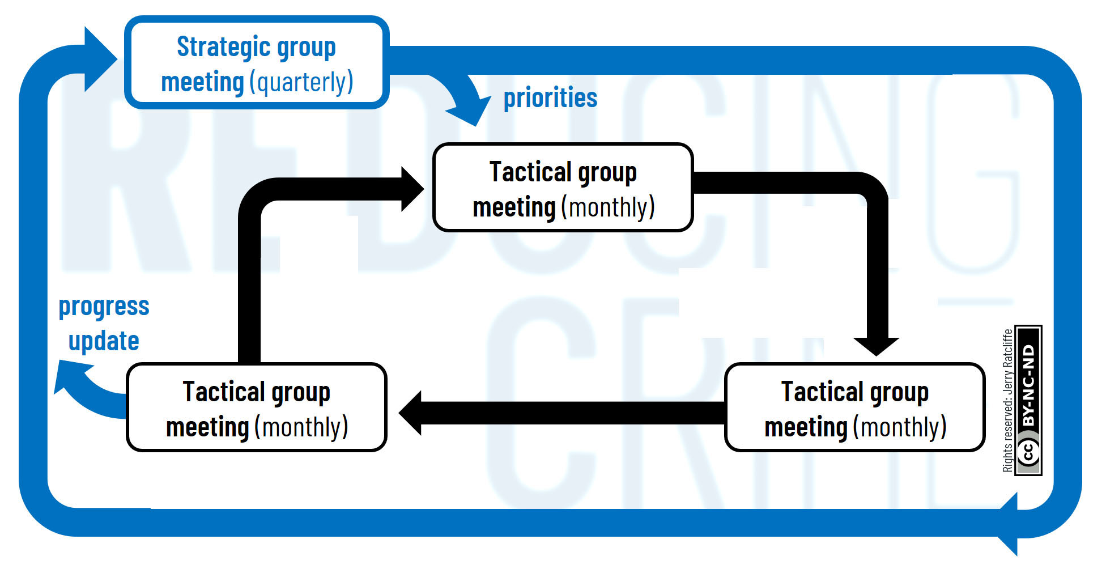
Source: Jerry H. Ratcliffe (2018) Reducing Crime: A Companion for Police Leaders. Routledge: London and New York.

